Slide 1
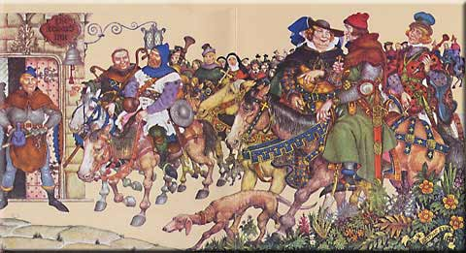
Geoffrey Chaucer’s
The Canterbury Tales
AP English Literature and Composition

Slide 2
Geoffrey Chaucer (1343 – 1400)
Born to a London family with land and money, but no title
  Limited chances for social growth/advancement
Estimated birth date: 1340 – 1345
Was a brilliant scholar and was well-educated
Became an official in the government, married a woman of rank, and was sent on diplomatic missions
  Had considerable political influence

Slide 3
Geoffrey Chaucer, cont.
Was a government official first and a writer second
1386 – lost political influence when his patron left the country
  Most critics believe this is when he began the CTs
1389 – patron returns, gives Chaucer a new, better government post
Died October 25, 1400
Buried in Westminster Abbey
  First writer entombed in Poets’ Corner
  Not because of literature, but because of loyal government service

Slide 4
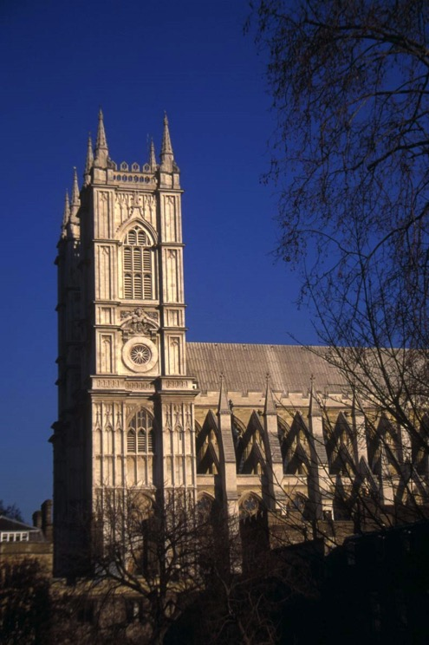
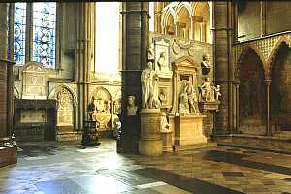
Westminster Abbey

Slide 5
The Canterbury Tales
Posthumous publication of unfinished manuscript 1400
  Each pilgrim was to have had 2 tales; only 24 completed
Important because....
  First book of poetry written in the English language
  Chaucer chose English over Latin and Italian
  Serves as a window into medieval social life
  Captured the variations of human temperament and behavior
    We still know these people

Slide 6
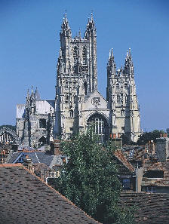
Why Canterbury?
Canterbury Cathedral was the site of a shrine to St. Thomas à Becket
Pilgrims believed relics of Becket’s shrine could heal sickness
Other reasons
  Giving thanks (Knight)
  Improving chances of salvation
  Atonement for sins
  Simple escape of travel

Slide 7
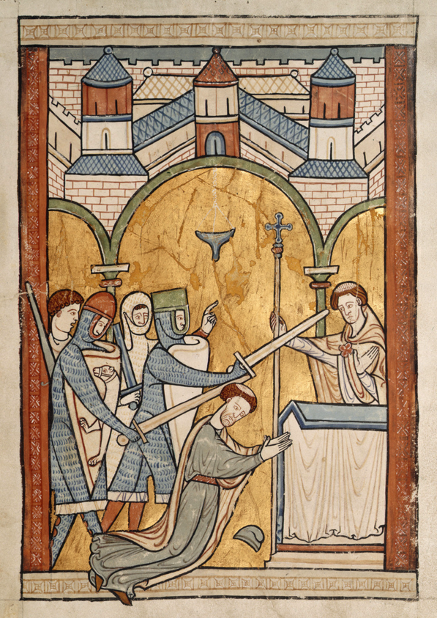
St. Thomas à Becket
Archbishop of Canterbury who excommunicated bishops who supported King Henry II’s idea that the State could try clergy for crimes
Henry cries, “Will no one rid me of this meddlesome priest?”
Four of his knights race to Canterbury and murder Becket at the altar of the church December 29, 1170.
This battle between church and state for primacy would continue until Henry VIII broke with Rome.

Slide 8
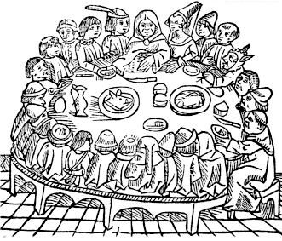
Chaucer’s Pilgrims
29 pilgrims including Chaucer himself
  The Poet-Pilgrim
  Represent the strata of medieval society
Started from the Tabard Inn in Southwark
Agree to pass the time with a storytelling competition suggested by their host, Harry Bailey, owner of the Tabard Inn

Slide 9
Literary Matters
Framed tale
  Prologue, story-telling contest
  Hearkens to Boccaccio’s Decameron
Uses iambic pentameter because it’s so close to the natural rhythm of English
Heroic couplets – iambic pentameter + rhyming couplets
Characterization methods

Slide 10
Genres within the Tales
Several different genres are present in the larger body of the work. These include:
• Romance: a narrative in metrical verse; tales of love, adventure, knightly combat, and ceremony (“Knight’s Tale”).
• Fabliau: a humorous, satirical, and often bawdy tale dealing with basic human desire for money, sex, or food (“Miller’s Tale”).

Slide 11
Genres Continued
Breton Lais: a type of fairy tale; set in Brittany province of France; contains fairies, elves, folk wisdom, and folktales (“Franklin’s Tale”).
Beast Fable: animals personify human qualities and act out human situations; usually teaches a lesson (“Nun’s Priest’s Tale”).
Sermon: a Christian lesson (“Parson’s Tale”).
Myth: a story originating in classical literature.

Slide 12
Genres Continued
Allegory: a tale in which a person represent abstract qualities (death, virtue, love)
Mock Romance: parodies, or makes fun, of the usual subjects of a romance (Nun ‘s Priest’s Tale”).
Pious legend (Saints’ Lives) – “Prioress’s Tale”
Exemplum: Narrative that teachers a moral lesson (“Pardoner’s Tale”).

Slide 13
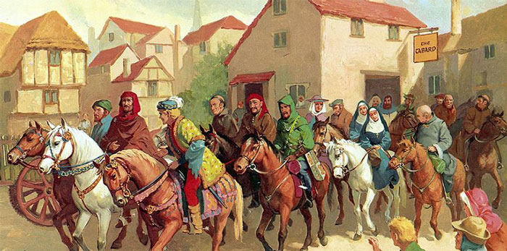
Mastery of Character
Characters are created through:
  Physical descriptions (some quite graphic)
  Characters interacting with each other
  The tales themselves reflecting character of the teller (often specifically their personalities and motivations)

Slide 14
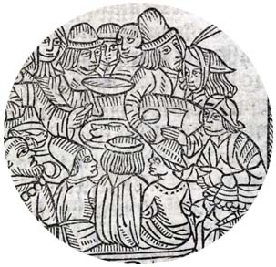
Layers of Society
Levels of Society
Aristocracy
Middle Class
Lower Class and Ruffians
Traditional Division
Those who fight
Those who pray
Those who labor

Slide 15
Look out for....
Physical characteristics
  Medieval ideology stated that a person’s physical appearance revealed their inner character
    Wife of Bath’s gap teeth, Prioress’ wide forehead
  Chaucer also includes these bits to let you know that many characters aren’t doing what they should
    Prioress’s pets and jewelry, Friar’s obesity, Pardoner’s long hair
Irony and Humor
  Chaucer uses puns and understatement to poke fun at his Pilgrims
  His humor is never cruel. He seems to recognize that all mankind has a bit of the ridiculous within.

Slide 16
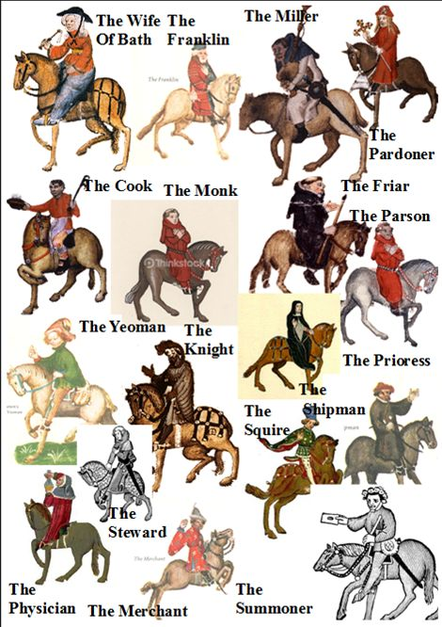
Now, let’s join the pilgrimage…

